Slide 1



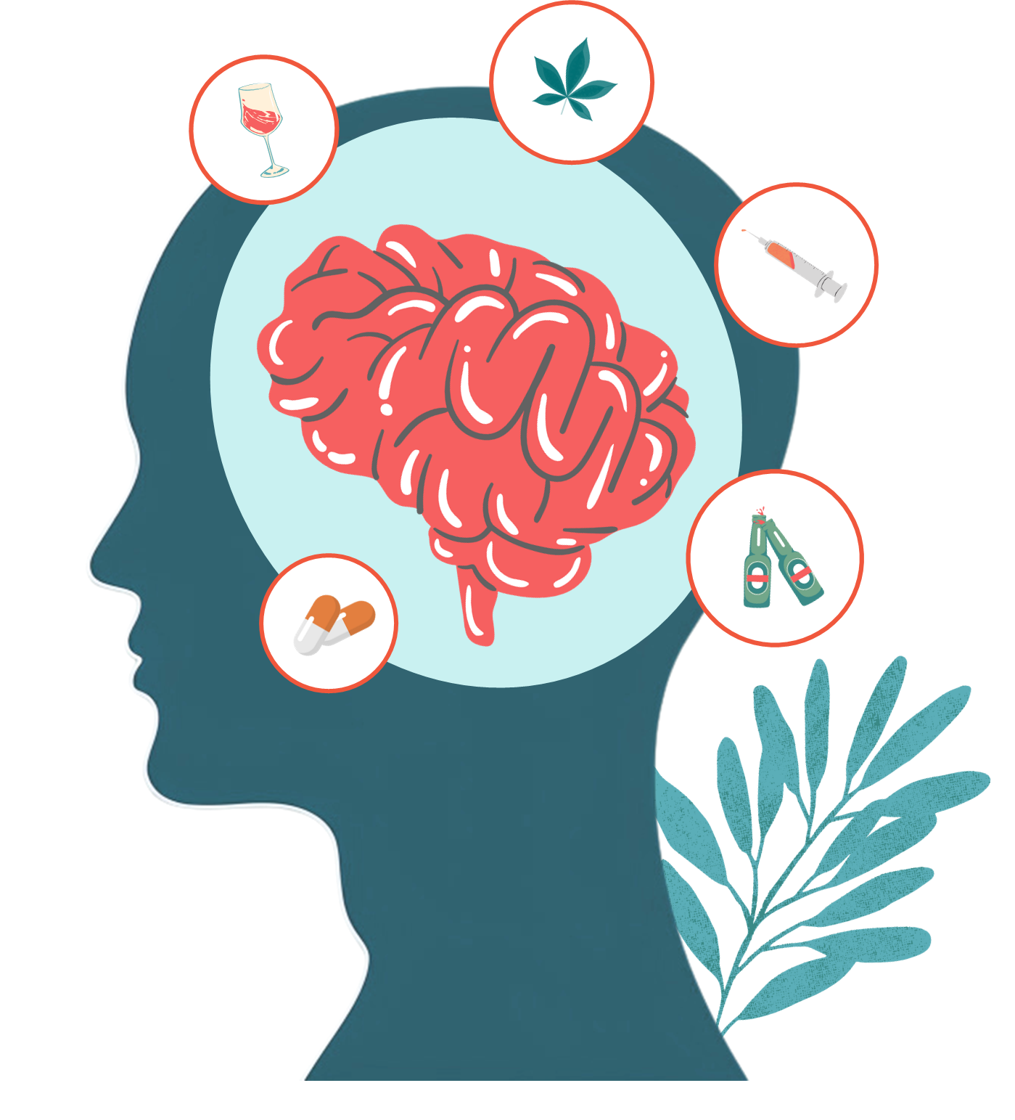



Mental Health Issues – Text Classifier
Marinescu Alexandru – Gr. 407

Slide 2





TABLE OF CONTENTS
01
02
03
04
INTRODUCTION
RELATED WORK
METHOD
CONCLUSION
Present the main purpose of the project
A use case scenario and related work in the field
Dataset, Preprocessing, Methods, Evaluation
Improvements, Ethical Statement, Limitations

Slide 3


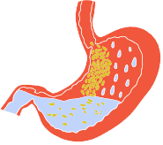





INTRODUCTION
Project is about a mental health issues text classifier, which has the following goals:
Determine whether a given text is related to mental disorders
If related, identify the issue from a predefined set of labels
The topic was chosen because mental health is a critical aspect of everyday life.
Can provide insight to experts, based on someone’s textual data

Slide 4



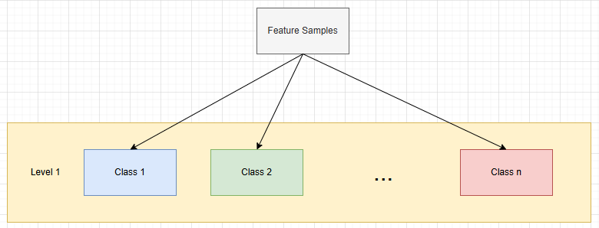
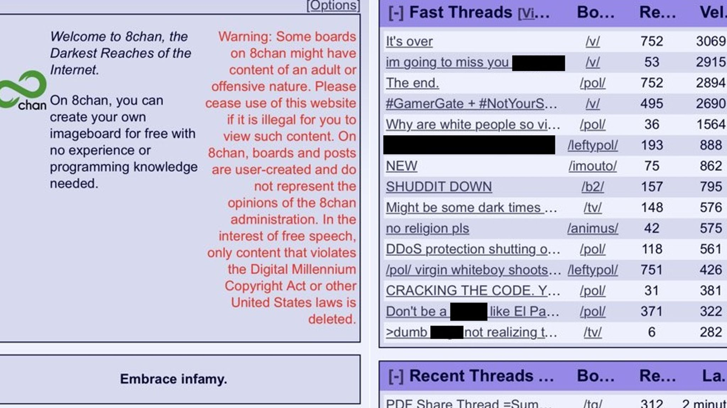
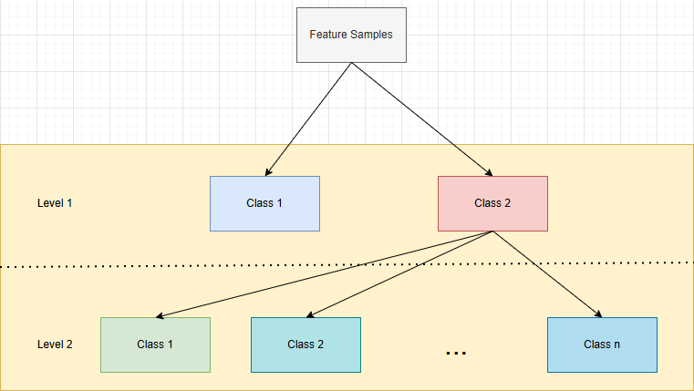
RELATED WORK
Effects of The Christchurch Attack (New Zealand, 2019)
Multi-Class Multi-Level Classification of Mental Health Disorders on Textual Data from Social Media

Slide 5


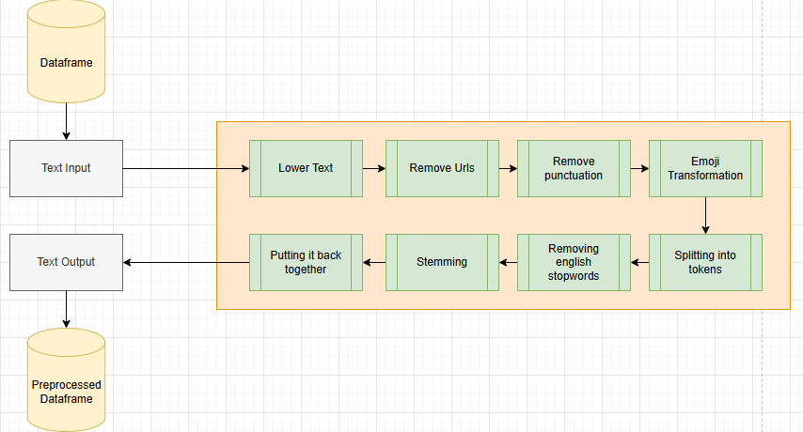

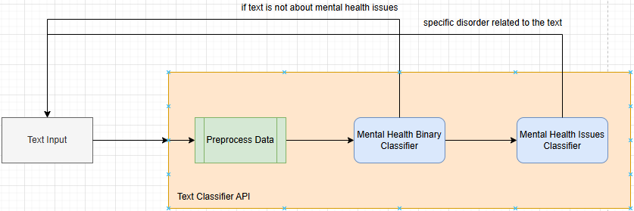


METHOD
Common Preprocessing
Main structure: 2 layer classification

Slide 6

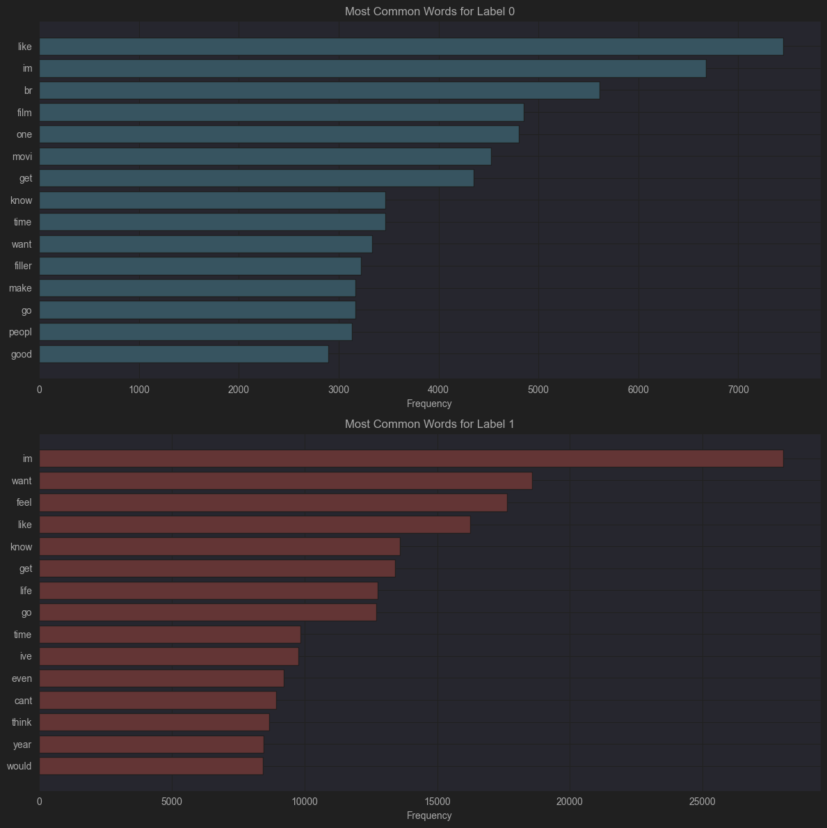
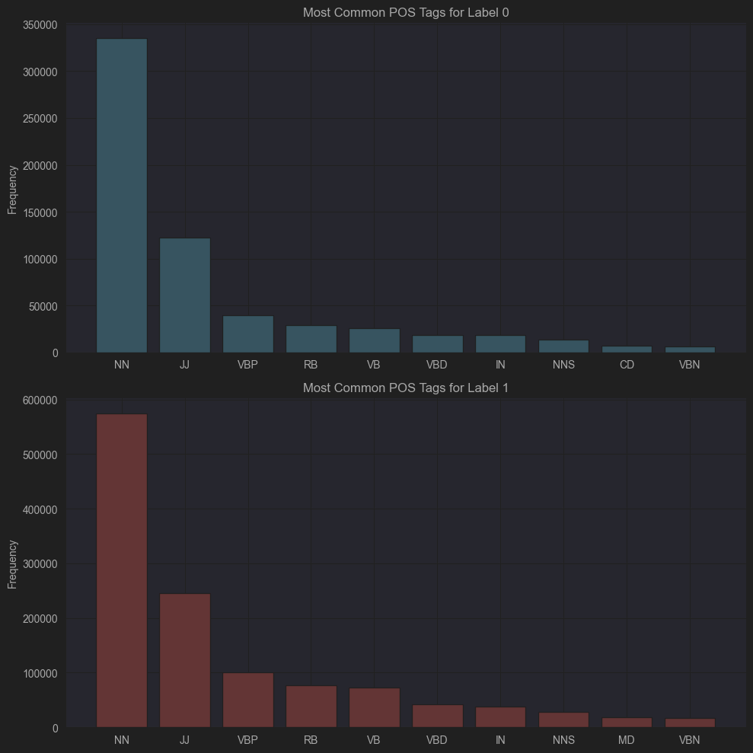
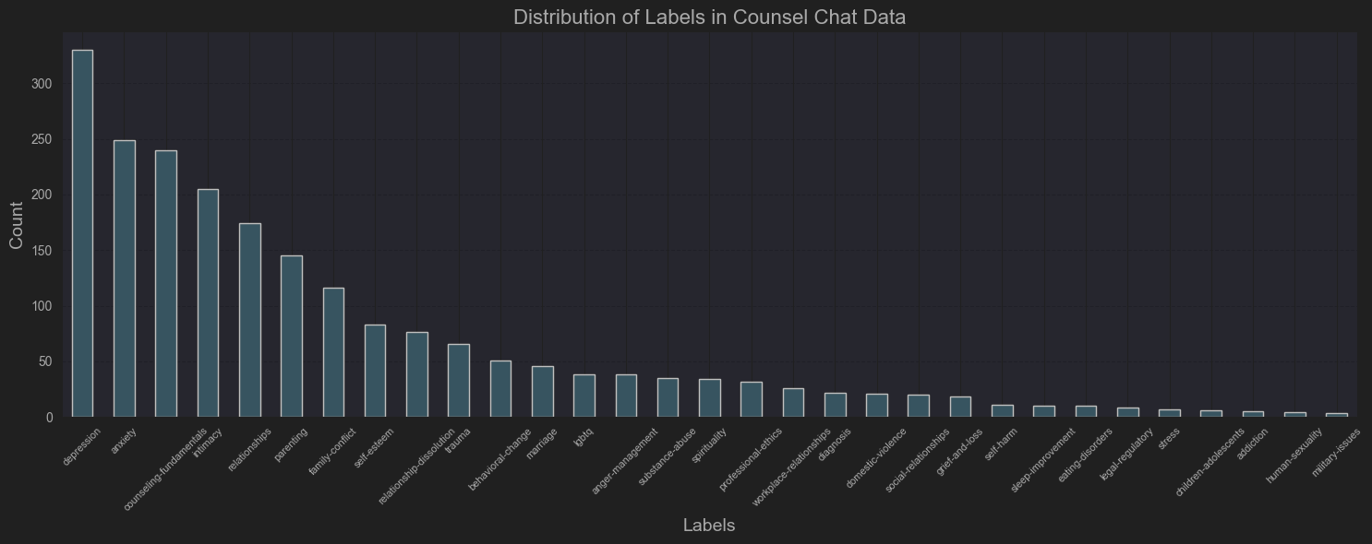



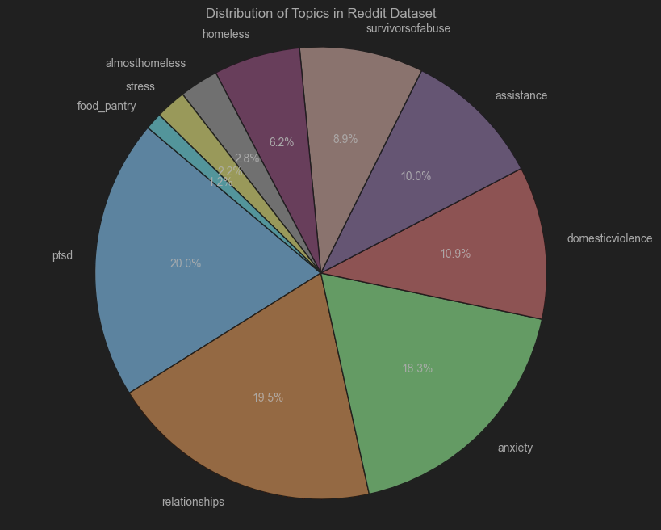
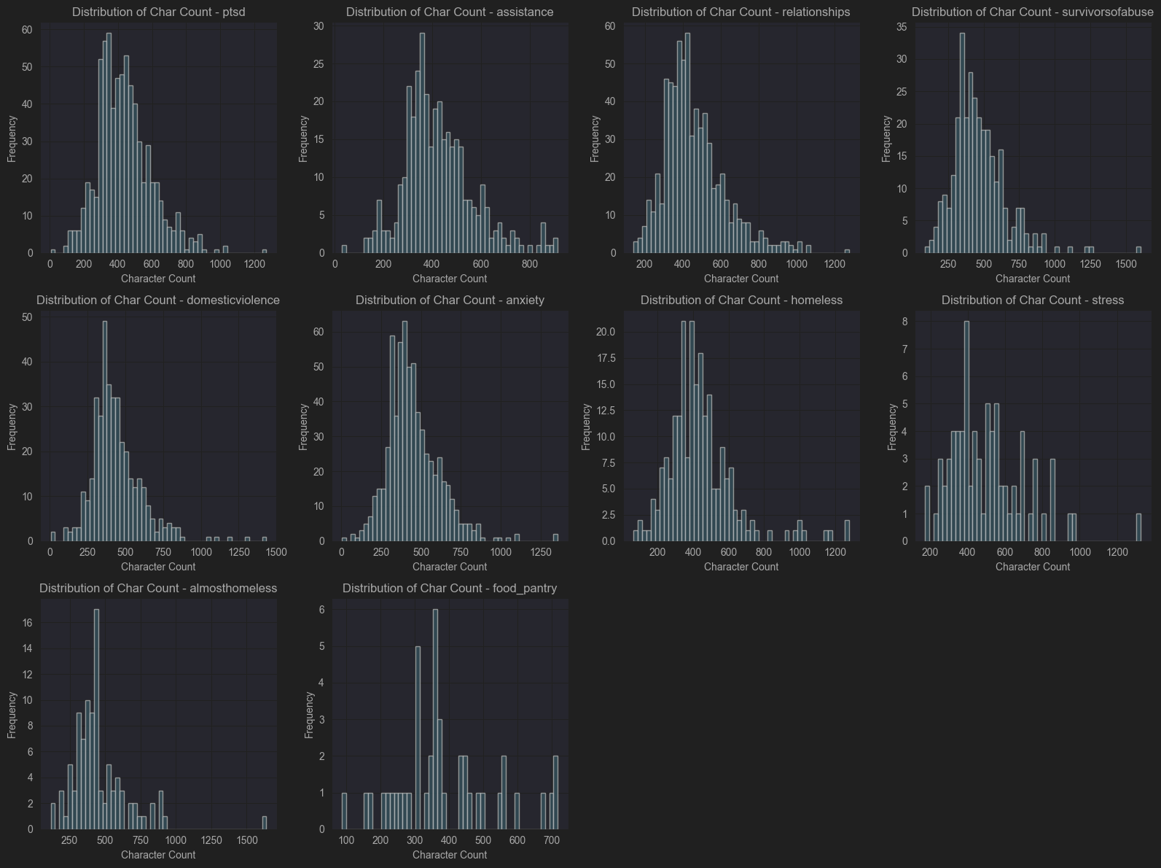


Binary Classifier Dataset
Counsel Dataset (Multiclass)
Dreddit (Multiclass)
Combined Counsel + Dreddit First 10 Labels (Multiclass)

Slide 7
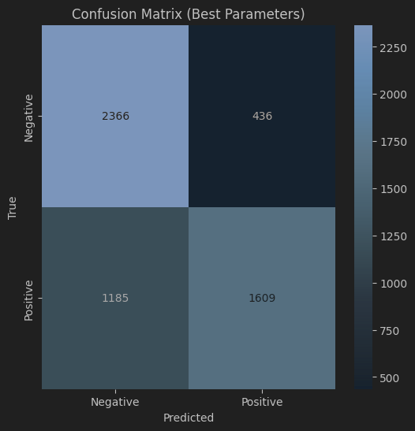
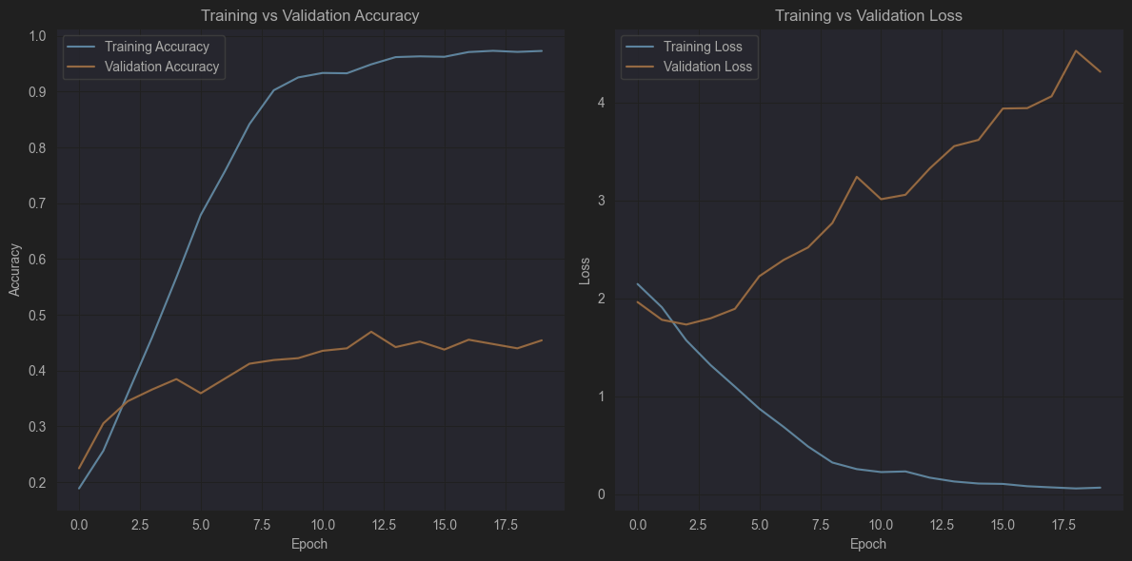
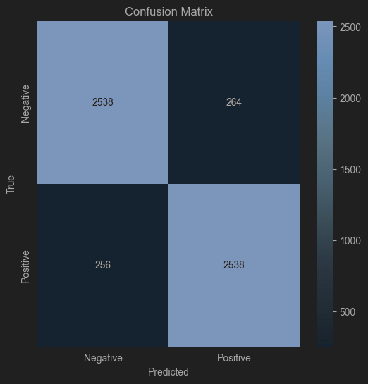
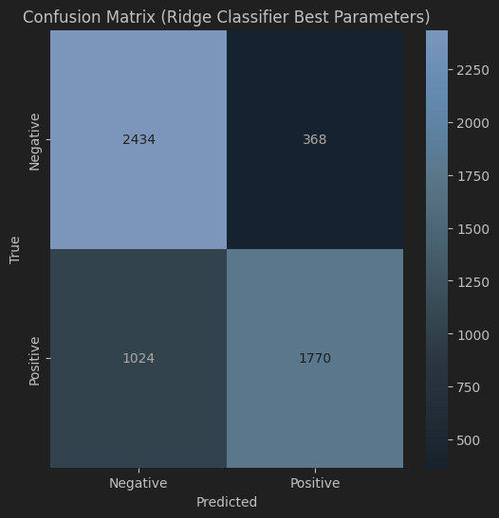

Example of model attempts - Binary Classification
Random Forest Confusion Matrix
CNN Evaluation Results
Ridge Confusion Matrix

Slide 8






CONCLUSION
Learned many topics such as TF-IDF, importance of data representation, analyzing cases using PoS and common words
Possible improvements down the line:
The dataset contained spelling mistakes, was unbalanced, and had limited topics (21 of 31 eliminated in the Counsel set)
Spell checkers like autocorrect's Speller could address spelling errors
Data augmentation techniques, such as back translation or synonym replacement, could mitigate dataset imbalance
Limitations:
Data availability
Hardware Constraints

Slide 9



THANK YOU FOR YOUR ATTENTION

